Slide 1


MRC London Intercollegiate Doctoral Training Programme (MRC LID)
2020-21 Induction
& Annual Cohort Update

Slide 2
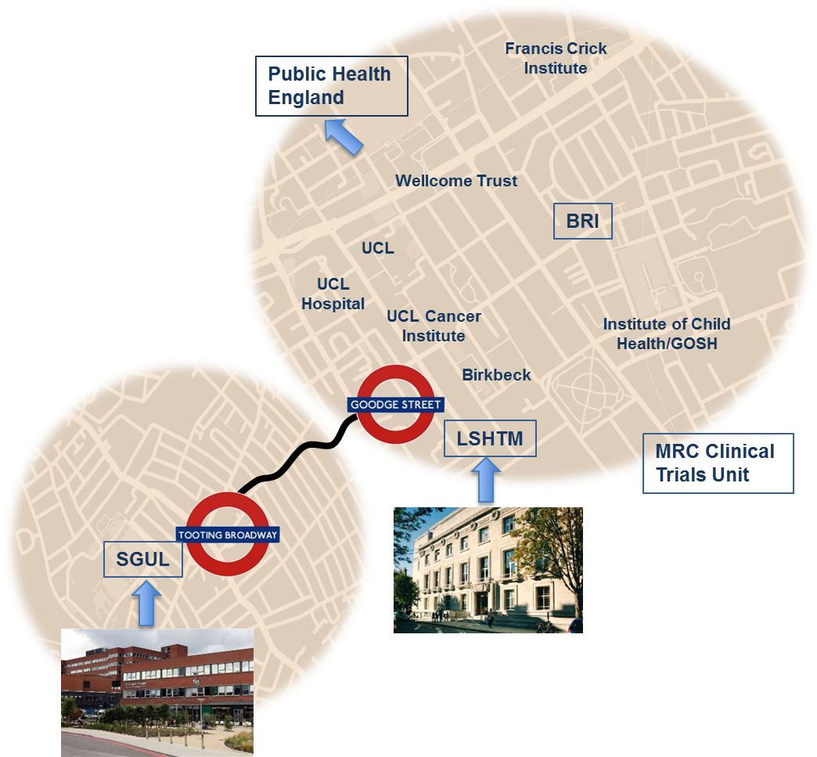
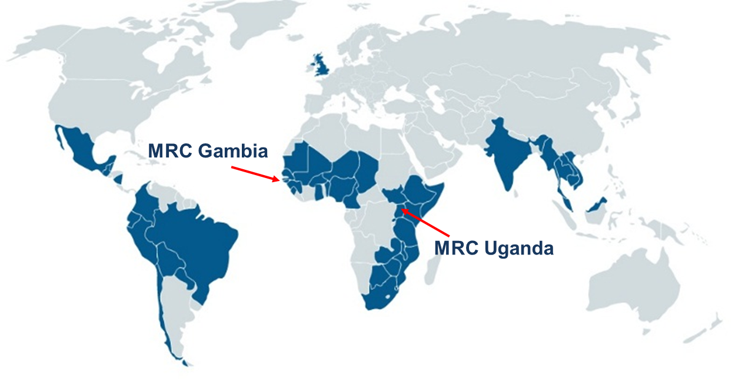
The partnership
LSHTM & SGUL
Shared research priorities
Global infectious diseases
Causal inference from large data sets
Evaluating complex interventions
Collaborative research
Antimicrobial resistance
Genomic medicine
Understanding asthma
Cardiovascular disease
Built environment, lifestyle and health
Complementary training
Genomic Medicine
Quantitative skills
Interdisciplinary skills

Slide 3
MRC LID Management
Board Members
Rachel Allen
Academic Lead / Co-Chair
Neil Pearce
Carwyn Hooper
Institutional Oversight
Suzanne Filteau
Alicia Showering & Eve Doran
Stas Vasiljevs
Student Representatives
Alexis Bailey
iCASE / Industrial Engagement Leads
Ian Douglas
Theme Leads
Global Infectious Diseases
Theme Leads
Quantitative Skills for Big Data Sets
Theme Leads
Evaluating Complex Interventions
Julian Ma &
John Edmunds
David Strachan &
Fizz Williamson
Steve Cummins &
Cally Roper

Slide 4
MRC LID Governance
Student representation
Research Degrees Committee (LSHTM)
Registration, performance monitoring, progression and regulation
Research Degrees Committee (SGUL)
Registration, performance monitoring, progression and regulation
Annual report
Progress monitoring reports
Progress monitoring reports
Board Membership
Academic Leads (Chair/Deputy Chair)
Pro-director of Teaching & Learning, LSHTM
Head of Graduate School, SGUL
Theme leads
Student representatives
Secretariat:
PGR admin lead, SGUL
LSHTM
Board
Strategic direction, programme management (including training & decisions on flexible funding), supervisor and project selection, student recruitment and support

Slide 5
What will you be doing?
Skills training and cohort building activities at both sites, including
  skills on the MRC strategic skills list
  (quantitative skills; interdisciplinary skills; whole organism biology)
  generic transferable skills training
  (starting with the Doctoral School/Transferable Skills training this term – required to attend this block training, but can select whether to do so at SGUL or LSHTM)
Taught modules
  Students are expected to undertake 4 modules over duration of award;
  If a course or module is available at either partner institution the MRC LID board expects it to be undertaken there rather than at a different institution (unless there are very good reasons for needing to do this).
MRC cohort training days (2 per year)
  First one will be a 2-day programme in November. The second is a 1-day programme in May.
  All MRC LID students are expected to attend all cohort training.
Social programme
  This is up to you (please discuss ideas with your student reps)!
Research

Slide 6
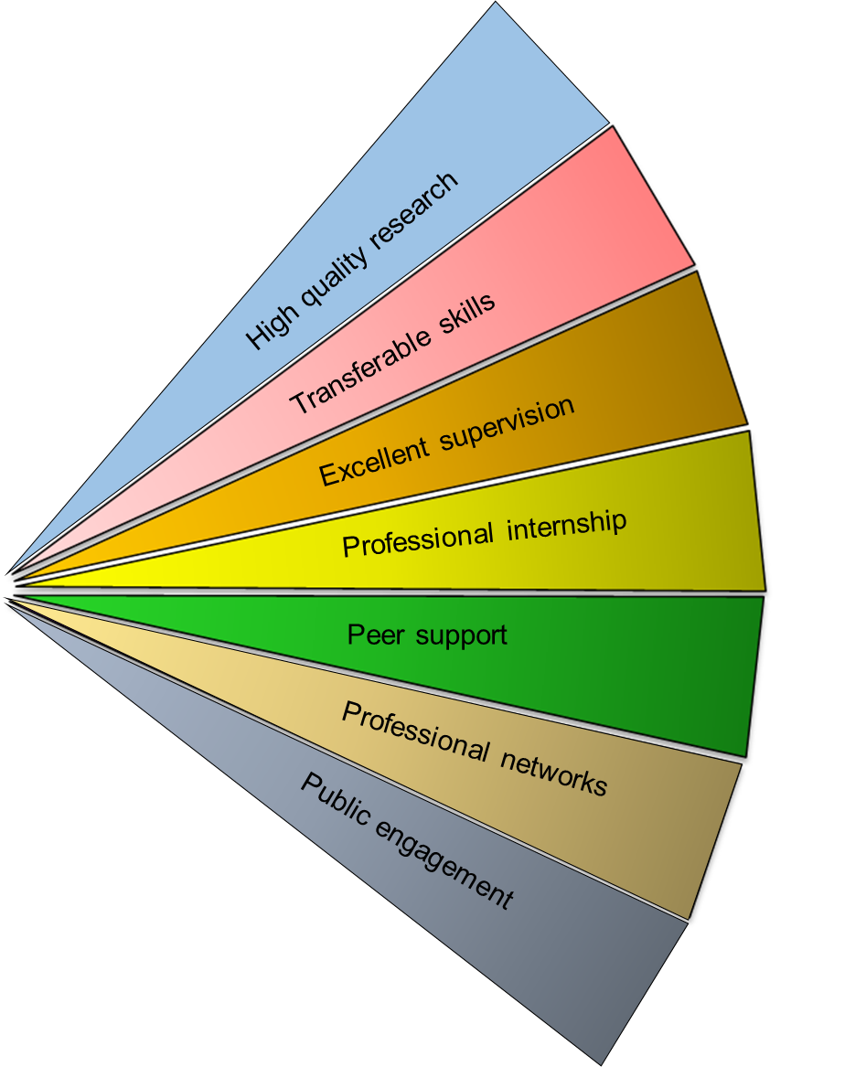
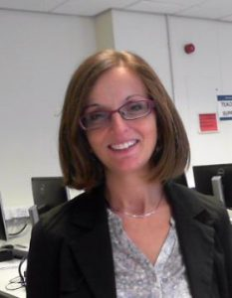
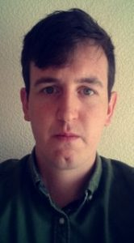
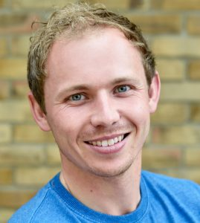
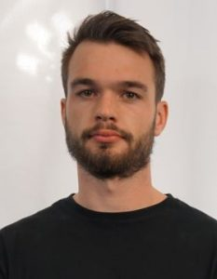
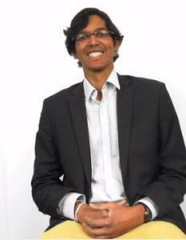
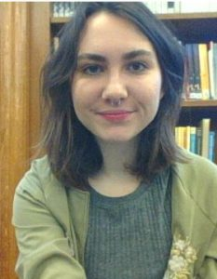


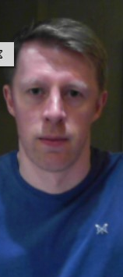
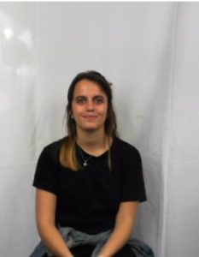
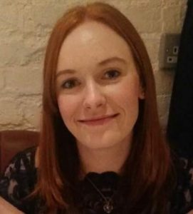
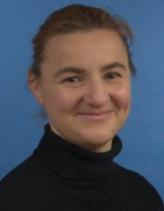
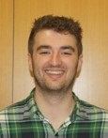
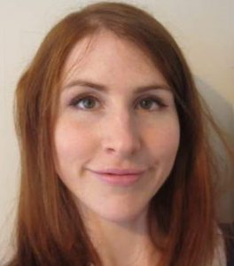
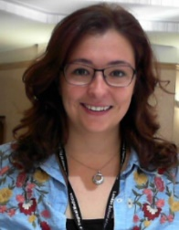
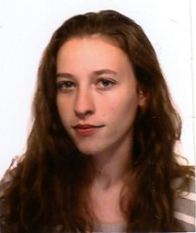
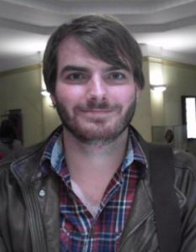
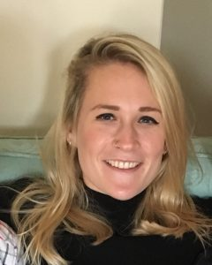
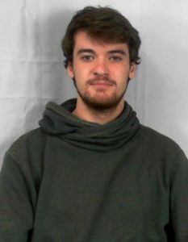
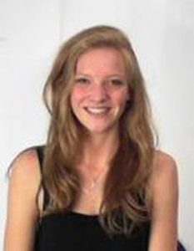
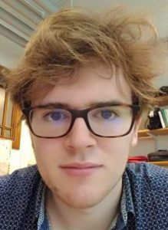
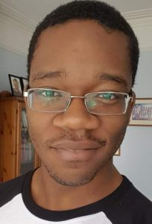
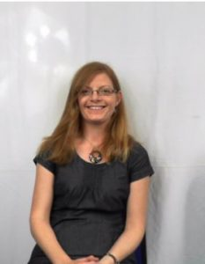
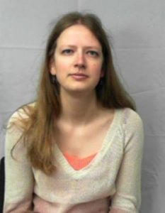
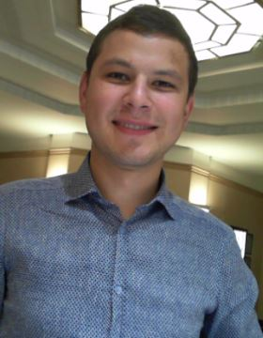
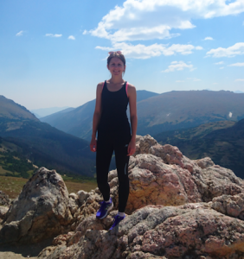
Enhanced training for future research leaders
Academically excellent
Highly motivated
Outward looking

Slide 7
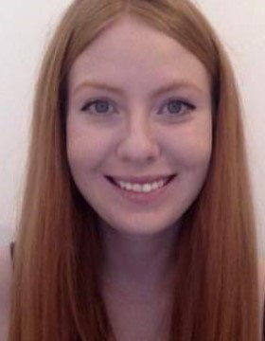
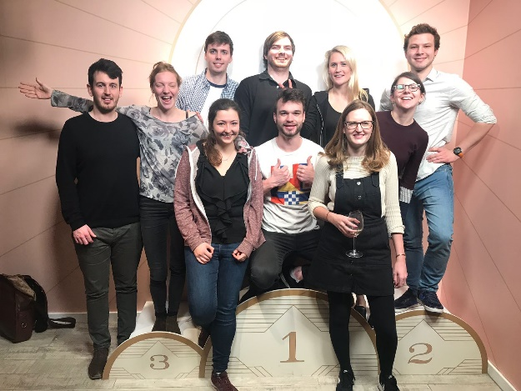
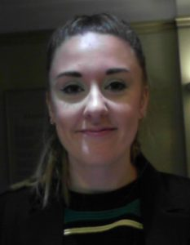
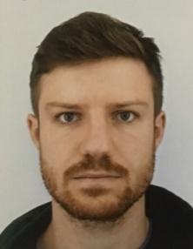
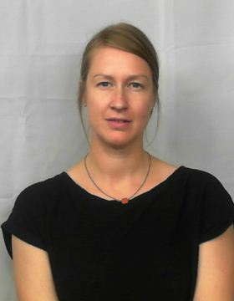
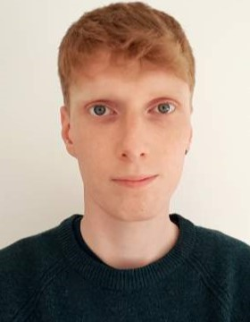
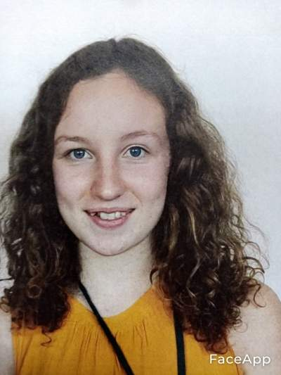
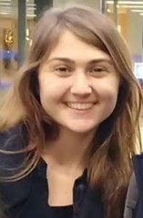
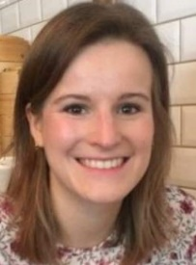
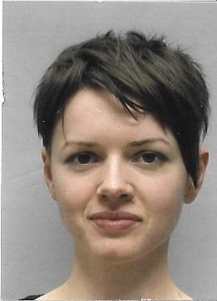
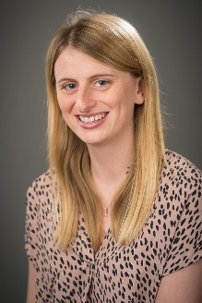
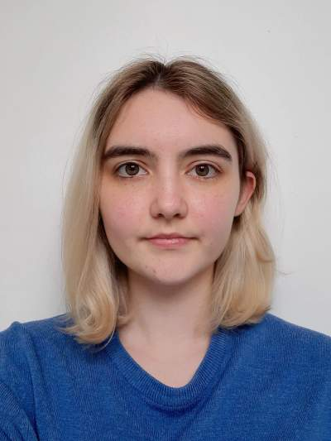
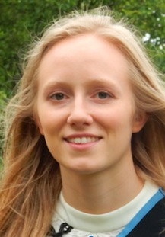
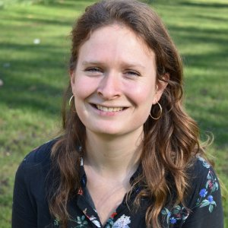
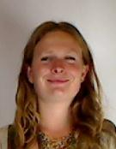
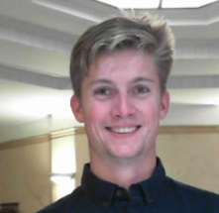
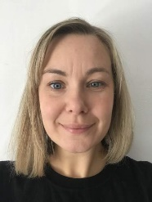
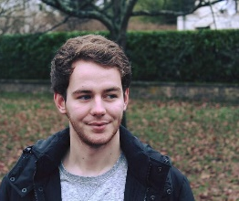
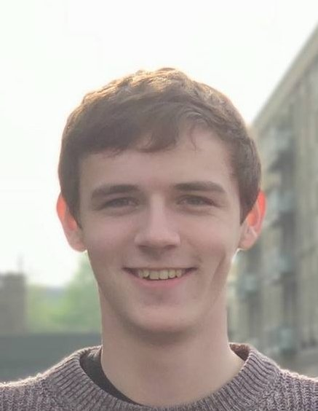
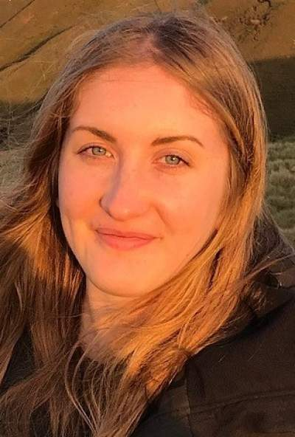
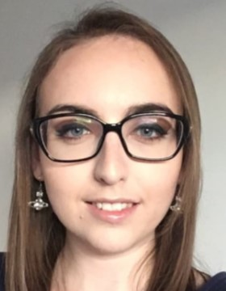
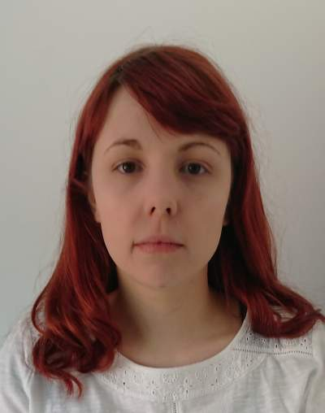
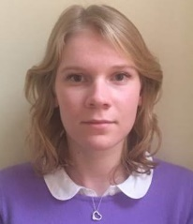







MRC Cohort
The current cohort (2020-21 academic year) includes students on the following awards
- 50 MRC LID (Standard)
- 4 MRC LID (NPIF)
- 1 MRC HTMR
- 1 MRF AMR
- and those funded by
MRC Units in The Gambia
& Uganda)

Slide 8

Meet the Cohort
2020-21 Student Representatives
Stanislavs Vasiljevs Alicia Showering Eve Doran
2017-18 Cohort 2018-19 Cohort 2019-20 Cohort
Based at SGUL Based at LSHTM Based at LSHTM

Slide 9
How was your project selected for the MRC LID scheme?
Criteria for assessing project and supervisor suitability:
- Does the project address an important issue in an MRC LID theme?
Global Infectious Disease
Quantitative Skills for Large Data Sets
Evaluating Complex Interventions
- Does the project provide high quality training in one or more MRC strategic skills areas?
Quantitative Skills
Interdisciplinary Skills
Whole Organism Biology
- Does the supervisory team have a good track record in research and in student supervision and meet institutional requirements?
- Can the project be carried out within the student’s £5,000 pa research budget or do the supervisors have access to sufficient additional research funds to fund the project?
Collaboration/co-supervision between SGUL and LSHTM strongly encouraged.
Therefore, any changes to a project or supervisory team must be approved by the MRC LID Board, as well as following any institutional requirements, before the changes are made.
Notes:
Process is long and involved to ensure that projects are
- well-thought through
- meet MRC skills criteria
- meet promises DTP made to MRC during the grant bid.
Therefore, any changes to either
- project or
- supervisory team
must be approved by MRC LID board before they go ahead.
(Please note that any changes must also be approved by the primary institution, as per standard RD regs.)

Slide 10
MRC LID Awards
DTP purpose = exceptional training opportunities across the MRC’s remit & strategic priority areas.
Our DTP (MRC LID) offers 2 types of awards (or routes).
3.5 year award
Fees
Stipend for UK-resident students
RTSG
Travel & conference allowance
Includes a 3 month internship
1+3 award
Fees
Stipend for UK-resident students
RTSG *
Travel & conference allowance *
3 month internship not required element of the award, but possible (with IoS)
Notes:
DTP given funds to provide exceptional training opportunities: we’d encourage you to look up the MRC’s ‘statement of expectations’ and skills priorities (on the Skills & Careers page: https://mrc.ukri.org/skills-careers/studentships/ ).
Basic summary of the two different types of awards.
RTSG = Research Training & Support Grant
Differences to highlight:
1+3 = funding for 1 yr FT MSc and then 3 years FT RD; RTSG and travel & conference allowance are available for RD (MPhil/PhD) years only
3.5 = 3 ½ years RD funding
Internship/placement is compulsory for 3.5 years (must be during reg time)
Internship/placement is not required for 1+3 but can be done (must take IoS for this).
Some students will have a slightly different award by having an iCASE studentship. These studentships will basically be one of the 2 noted here, but will include any additional funds provided by the industrial partner (stipend or RTSG or both, in cash or in kind).

Slide 11
Placement / Internship
Essential or optional?
Duration?
What?
Where?
When?
£
Approval & Feedback
Notes:
Essential or optional? Depends on your award: essential for 3.5 year awards (within period of registration, as per MRC rules); optional for 1+3 (taken as IoS).
Duration? 3 months
Where/What? The placement in an area completely unrelated to your PhD study was a key element of our DTP bid. Its purpose is to provide students with experience of the wider research environment, demonstrate how research feeds into the development of products or policy, expand the student’s network of contacts, facilitate their career development, and give access to expertise beyond their immediate research group.
Not at LSHTM or SGUL.
Discuss areas of interest/ideas with your supervisors, other academics who may have links to your host, and your MRC LID mentor. Check whether they have any contacts and other ideas. Ask the MRC LID Board via the admin email address.
When? After upgrading. Other that that to be taken at a time that is suitable for you and your supervisor, with minimal disruption to your research, (and that’s suitable for the host organisation).
Who pays? And what? Non-lab students are expected to use their RTSG allowance to cover costs. In some instances, where this is insufficient discussions should be had with MRC LID admin in the first instance. For lab-based students MRC has provided the DTP with a flexible funding supplement to cover some extraordinary training costs. Costs of travel and accommodation can be covered. The DTP will not cover food or drink (unless for 1+3 IoS or duration over 3 months) – ordinarily this should come out of your stipend.
Approval? Required before you complete planning and undertake the placement. Submit Placement Form to MRC LID Board via mrclid email in good time.
Feedback? Return a completed form to the admin team on your return (for reporting/records etc).
(Examples from current cohort?)

Slide 12
Conferences & Training
CONFERENCES
Conference attendance expectation = 2 UK or EU + 1 overseas, as appropriate.
RTSG
TRAINING
Exceptional student-led training.
Cohort Personal
* Twice a year (usually Nov & May) Should be more than standard PhD
* Student Reps will liaise with Board re: requests * Transferable skills training (compulsory)
      * Other skills (PhD; MRC priority skills list)
* 4 Modules
* External options
* (1+3 – MSc is training! Above refers to MPhil/PhD)
Notes:
CONFERENCES
Conference attendance likely to vary depending on student; area of study.
MRC LID anticipates 2 * UK or EU + 1 * overseas
Travel & conference allowance should be used for travel/accomm. If more required can dip into RTSG if it’s available. Importance of budgeting!
RTSG can be used for formal conference dinner but not other food & drink.
Your primary institution may have other sources of funding for conference attendance, so check.
TRAINING
Exceptional student-led training
- Cohort training (at least twice a year; please plan to attend as board expects 100% attendance unless on placement away)
Personal training
for your PhD;
gaining skills that wouldn’t necessarily be available through a non-MRC LID funded PhD;
external courses – should only use RTSG/flex funding if not available at LSHTM or SGUL (or there’s a reason you wouldn’t be able to attend the local course);
4 Modules – LSHTM module registration deadline for Term 1 = 2.00pm today! (RLID to Lauren).
Must attend transferable skills – can be at either institution but likely to be at your primary institution.)

Slide 13
Money
Notional award value each year. 2020-21 notional studentship amounts:
Notional values usually increase year-on-year. Actual UKRI Studentships rates usually published early Spring for next AY.
MRC website: https://mrc.ukri.org/skills-careers/studentships/ (see DTP/Studentships section).
PAYMENT TYPE | AMOUNTS PER ANNUM | DESCRIPTION
Minimum stipend | £17,285.00 | Tax-free payment. Includes £2,000.00 London weighting
Fees | £4,407.00 | Sessional fee including tuition, supervision, registration and bench fees. LSHTM & SGUL top-up fees to institutional levels.
RTSG | £5,000.00 | Contribution towards consumable costs of training research students. Amount can be reduced where value is in excess of individual project requirements (eg “dry-lab” based projects; or where consumables have been leveraged from external sources), to minimum of £1,000.00
Travel & conference | £300.00 | Contribution to the costs of attending scientific conferences, workshops, or visits to collaborators.
Notes:
DTP receives from MRC notional award value per student. Plus each HEI has committed to support an additional number of studentships per year.
All amounts shown are passed on to covering your costs. Additional funds from your primary institution top-up (cover) the remainder of fees due each year.
Award values change year-on-year (usually increased in line with inflation, based on the Treasury GDP deflator.
Amounts set by MRC are shown on MRC website: https://mrc.ukri.org/skills-careers/studentships/ (see DTP/Studentships section).
In addition to the notional award value we receive a ’flexible supplement’ from the MRC. MRC LID calls this ‘flexible funding’.

Slide 14
How does RTSG work?
RTSG Allowance = a notional per person value from UKRI of GBP 1,000.00 – GBP 5,000.00
Students with dry-lab or non-lab based projects
RTSG should cover laptop; software; fieldwork; 3-month placement; high cost training; institutional visits.
Not to be used for significant project changes or data collection – that should be covered by supervisors’ funds.
Full notional allowance given on the understanding that you will use it wisely and invest in your future self with good quality training.
Can be reassigned to lab students or other MRC cohort students to ensure best use of the funds across all students.
Be wise. Don’t waste/be profligate! Think of the MRC Cohort community.
Students with lab-based projects
Full amount contributes to lab expenses (apply for flexible funding for 3-month placement & high cost training)
Conference/Travel allowance = GBP 300.00 pa.
Once this has been used for travel/conference you can dip into your RTSG if you have any £ available.
It is not possible to use flexible funds for conference attendance.
To note:
Use RTSG/travel/conference allowances first, before applying for flexible funding.
No food & drink except a formal conference dinner (Board has agreed that this fund can be used to attend a conference dinner, as a networking opportunity.)
Can’t use what you haven’t ‘earned’ – no overspend please (your responsibility to keep track)! Unused allowances from previous years can be carried forward.
RTSG & Conference/travel allowance held by JREO (SGUL); Faculty RD Office (LSHTM – EPH & PHP); Dept (LSHTM – ITD).
Notes:
RTSG Allowance is a notional per person value from UKRI. GBP 5,000.00
Many DTPs choose to give non-lab students just GBP 1,000.00 – GBP 2,000.00 pa. We give you the full notional allowance on the understanding that you will use it wisely and invest in your future self with good quality training etc. This means that non-lab students should be able to fund their placement and all training from their RTSG allowance, and possibly have some left over to share with other cohort members. Don’t waste the money just to use up the funds because you can – this isn’t an LSHTM grant where equipment has to be bought just to use the funds etc. Please be thoughtful of the entire MRC LID community and opportunities.
We assume the full allowance will be a contribution towards lab consumables for lab-based students. Therefore, the flexible funding (and unused RTSG allowance from non-lab students) will be needed to undertake additional training and the placement.
Conference/Travel allowance
GBP 300.00 pa. Once this has been used for travel/conference you can dip into your RTSG if you have any £ available. Board has agreed that this fund can be used to attend a conference dinner, as a networking opportunity. It is not possible to use flexible funds for conference attendance.
Not to be used on food & drink (stipend should be used for this).
Can’t use what you haven’t ‘earned’ – no overspend please (your responsibility to keep track)! Unused can be c/f.
These funds are administered through Faculty / JREO.
Reporting – you’ll be emailed quarterly from the LID team with a detailed email and spreadsheet to update. You’ll need to either keep a running record yourself, or liaise with your RDM or DM. If we don’t receive an expenditure report we’ll send you one reminder but after that it will be recorded that you had no expenditure to submit and therefore your faculty might be out of pocket.

Slide 15
How does flexible funding work?
What is it?
Flexible Funding or supplementary funding = additional money from MRC.
Limited pot (as MRC has given no assurances that there will be more in the future).
Requires MRC LID Board approval.
Available to entire MRC Cohort.
MRC’s examples of supported use of this flexible funding (within broad areas) includes:
- high cost training, which could include training in MRC skills priorities; bioinformatics; modelling; or advanced in vivo training
- exceptional training opportunities eg overseas fieldwork; internships/placements; lab visits/training; training in new advanced research skills; industrial collaborations
- opportunities to provide training in partnership working with industry or at the interdisciplinary interface eg internships/placements; collaborative training; attracting individuals from another discipline into MRC studentships
- transitions from PhD for outstanding candidates to increase competitiveness in applying to positions within and beyond academia, following thesis submission.
How to Apply?
Basic info on MRC LID web pages & in Studentship Handbook.
Apply for flexible funding in plenty of time for board comments/approval and for payment to be processed before you plan to use the funds.
Some other useful info:
MRC LID students: Plan. Allocate and used (wisely) RTSG/travel/conference first. Not available for work of PhD/project costs (eg data collection), even when there are significant project changes, as these costs should be covered by supervisors.
Non-MRC LID cohort students can apply for MRC flexible funding for training and/or 3 month placement.
Notes:
Flexible Funding = flexible supplement = supplementary funding
MRC funds provided over and above per student notional award (fees, stipend, RTSG, travel/conference). Sum given each year (so far) but pot is limited and MRC is unsure anymore will be forthcoming.
Allocated at the DTP’s discretion (local decision making) so Board approval is required for use of these funds.
MRC Cohort = all MRC-funded students (including LID) at both institutions.
Apply via MRC LID email (form on web pages). Apply for flexible funding in plenty of time for board comments/approval and for payment to be processed before you plan to use the funds. You’ll see from the FF pages online that you will need to include a budget for both your flexible funding application, and also your RTSG expenditure to date, or how you are planning to use it.
MRC LID students: Budget; use RTSG and travel/conference first. Not available for work of PhD/project costs (eg data collection), even when there are significant project changes, as these costs should be covered by supervisors.
Cohort students (not MRC LID): can apply for MRC flexible funding for training. They may be able to use flexible funding to undertake a 3 month placement but would need to have the permission of their grant holder and supervisors to do this – must get permission before organising. If the placement was unconnected to their research project they could take an IoS for the 3 months.

Slide 16
Money Summary
What do I use when?
How can I access it?
 | Non-lab | Dry lab | Wet lab | Who holds £? | Other Admin
RTSG GBP 5,000.00 pa* | Other costs: laptop or computer (big data only); AND training; placement etc | Contribution to lab consumables AND other costs (training; placement etc) | Contribution to lab consumables | SGUL = JREO EPH = Lauren PHP = PHP RDA Admin ITD = DOO or Supervisor | Report to MRC LID Admin every quarter – after expenditure is used / incurred
Travel/ Conference (GBP 300.00 pa*) |  |  |  | As above | As above
HEI support |  |  |  | As above | N/A
Flexible Funding ** To be used after RTSG and travel/conference has been accounted for. Only if MRC LID Board has approved spend in advance. |  |  |  | MRC LID Admin | Report & receipts to MRC LID Admin on return
* Amounts pro-rated for period of registration ** MRC has provided guidance to the DTP board that these funds must be used for MRC LID Admin, for the purpose of this table, is the Scholarships team in Registry at LSHTM
QUESTIONS TO ASK FOR BUDGETING:
What does your standard award cover?
What else do you need to undertake your research?
What else do you need for your placement?
What else do you need to make the most out of this studentship funding opportunity?
What is your research project?
Notes:
Use RTSG/travel/conference allowances first, before applying for flexible funding.
RTSG/travel/conference must be 'earned' - you can't use more than the allowance for the current year plus any unused amounts carried forward from previous years.
Apply for flexible funding in plenty of time - it will take time to get MRC LID Board comments/approval and for payment to be processed.

Slide 17
Reporting & admin
Key information we need to get from you at various stages through your award (and after) to fulfil our reporting obligations, includes
Je-S
RTSG actual expenditure
Annual Training Plan
Profile on MRC LID pages
Flexible Funding Feedback Form
Placement Approval Request & Placement Feedback Form
Annual MRC Report
ResearchFish
Final destination data
This information is used by the MRC to determine outputs and individual and DTP impacts, and to assess HEIs.
The information (and quality of information) provided may have implications for future funding and awards.
Please help us to support you by engaging with the programme and responding to requests for this (and any other) information.
Notes:
Je-S: Project summary must be in layman’s terms, and tick as many MRC core skills boxes as possible. This is required within 1st month. Then update annually, or when any changes are made to student status or project.
RTSG actual expenditure: Must be reported quarterly in arrears ie after it’s happened. Team will contact you.
Annual Training Plans: With an MRC LID board mentor (annually – meeting with supervisors & MRC LID board member to consider training and other opportunities outside standard PhD). Opportunity for input from someone else. Not a box-ticking exercise!
Profile on MRC LID pages: updated annually (late summer)
Flexible Funding Feedback Form: to be completed and submitted after training or placement which used flexible funds
Flexible Funding Feedback Forms (following training or placement where flexible funding has been used)
Placement Feedback Form
to be submitted before/after placement
Annual MRC Report: uses the information provided by students and their supervisors throughout the year.
ResearchFish: annual request; usually from the start of Year 3 FTE and for 5 years after completion of award
Final destination data: following completion

Slide 18
General Information
More information on your award can be found on the MRC LID website. In particular, please see: Current Students tab (Studentship Handbook; flexible funding; forms; and Terms & Conditions)
For general info about Research Degrees at your primary institution, and processing RTSG funds, please contact
For MRC LID queries, including about fees and stipend payments, flexible funding applications, and reporting/general admin please contact the Scholarships Team at LSHTM
SGUL PGR
Derilyn Frusher (PGR in Registry)
TBC (JREO for RTSG)
LSHTM - EPH
Jenny Fleming
Lauren Dalton
LSHTM – ITD
Helen White
LSHTM – PHP
Joanna Bending
Renee Olivel
Lara Crawford
DTP Admin Lead &
Scholarships Manager
Birgit Kertscher-Benn (PT)
Dot Delpech (FT)
Wendy Raatz (PT)
Vacant Post
(PT)
Scholarships Administrators

Slide 19
Lastly …
We hope you will enjoy your studies, and make the most of this great scheme!
Because it is unique, and a little bit special, there are a few bits that don’t follow the standard LSHTM or SGUL ways, or differ across the 2 MRC LID routes, so if you have any questions (or are starting to make assumptions) please just ask us.
E: mrclid@lshtm.ac.uk
Face-to-Face: For now, arrange a Zoom. But hopefully if the future … pop into LSHTM Registry and see us.
T: 020 7299 4785 or 4839

