Slide 1
MRC London Intercollegiate Doctoral Training Partnership Studentships
Neil Pearce, Neil.Pearce@lshtm.ac.uk
Carwyn Hooper, chooper@sgul.ac.uk
Elizabeth Brickley, Elizabeth.Brickley@lshtm.ac.uk
Vanessa Ho, vho@sgul.ac.uk
Lara Crawford, mrclid@lshtm.ac.uk

Slide 2
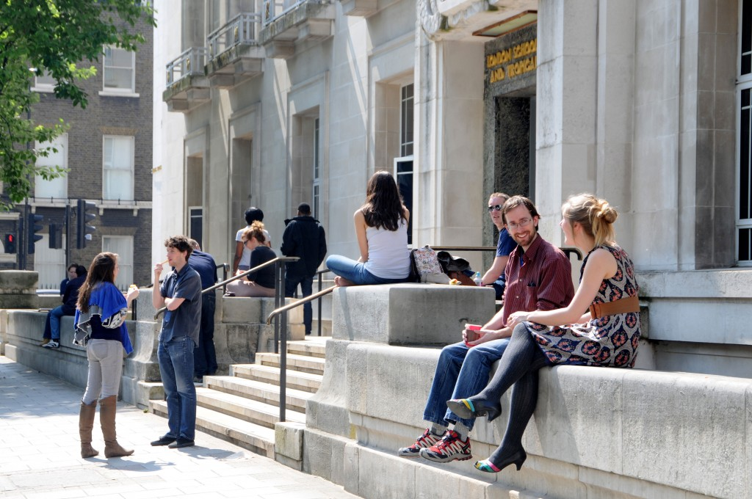
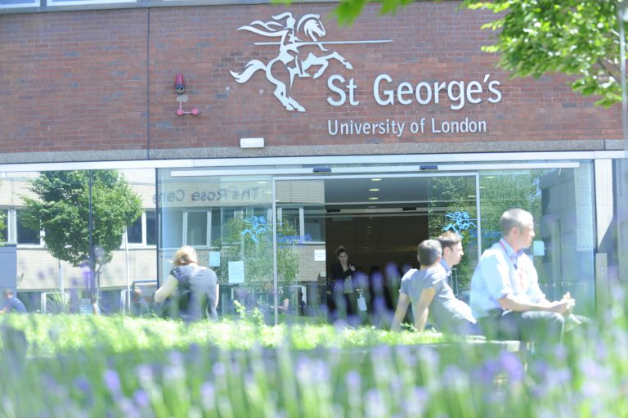
Program Overview
Partnership between LSHTM & St. George’s, University of London (SGUL)
Builds on successes of 7-year doctoral training partnership, which has administered 66 studentships.
Awards up to nine notional PhD studentships per year.
Standard studentships of 4 years
1+4 option of Master’s then PhD
Covers:
Tuition fees & stipend
Annual funding for research training, travel, and conference
Competitive flexible funding for fieldwork, public engagement projects, etc.
Includes support for 3-month internship

Slide 3
MRC LID DTP Themes
Student-centered, interdisciplinary projects with a uniquely international focus
Global health
Health data science
Translational & implementation research
Infectious disease
Research to address health inequalities, including projects related to planetary health and climate change, global non-communicable disease, and health effects of sustainable development and urban design
Research utilizing quantitative skills, such as modelling, data analytics, artificial intelligence, and machine learning
Research emphasizing bench-to-bedside approaches as well as links to health policy and economics
Research focused on infectious diseases, encompassing both basic science and population-based approaches

Slide 4
mrc-lid.lshtm.ac.uk

Slide 5
EDI Strategy
Our strategy adopts a proactive approach to EDI with a firm commitment to anti-racism and to decolonising global public health research.
Mandating training for supervisors
Widening recruitment strategies
Expanded links with Post ‘92 Universities
Open Days and social media outreach
Taking positive action to recruit and support historically underrepresented groups
Ring-fenced 1+4 scheme for UK minority ethnic students
Pre- and post-acceptance mentoring by EDI leads
Increasing diversity on interview panels and board
Providing bursaries to students from LMICs
Creating flexible opportunities to support student carers
Using data and student engagement to monitor and evaluate impact of EDI strategy

Slide 6
Mandatory training for supervisors
Overview of MRC LID & expectations for supervisors
24 Sept 2021 and recorded
Equality, diversity, and inclusion (EDI) and unconscious bias
24 Sept 2021, 27 Sept 2021, and TBD
Microaggressions and being an active bystander
4 Oct 2021, 7 Oct 2021, and 13 Oct 2021

Slide 7
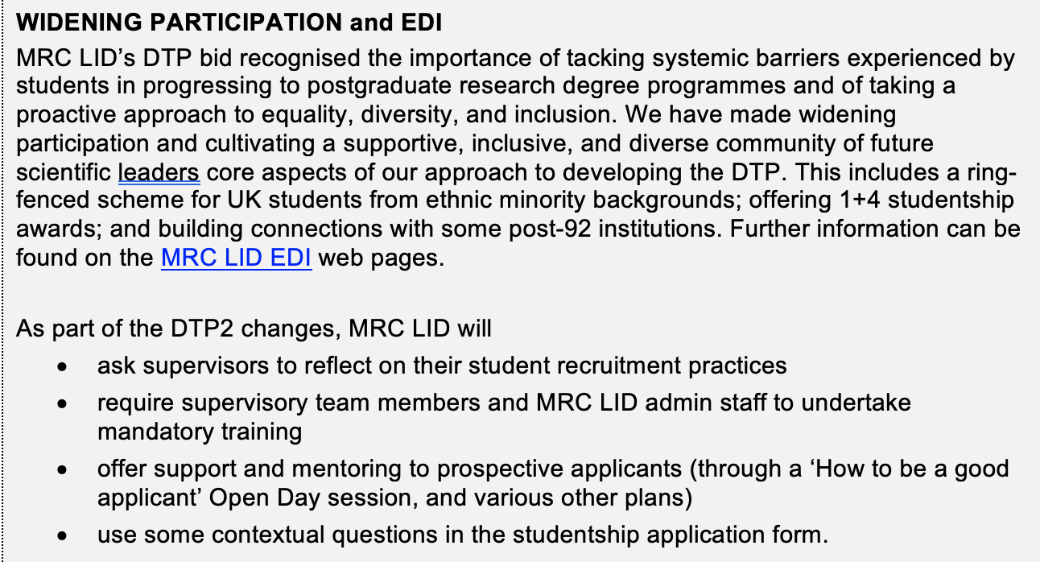
EDI in project proposal submission
Potential supervisors will submit projects by 13 Oct 2021.
A new section of the application asks for reflection on widening participation & EDI.

Slide 8
Student recruitment
Raising awareness of ring-fenced scheme for up to three 1+4 studentships per year for UK students from ethnic minority backgrounds.
Current initiatives
LSHTM Alumni Network
Higher Education Race Action Group
Leading Routes
HDR UK Black Interns Programme
Future work
We are working to expand links to Post ‘92 Universities

Slide 9
Open day
Working with current RD students and Doctoral College to develop Open Day.
Primary Aim: Widen participation through focus on transferable skills
Presentations - not only provide overview of this program, but also disseminate more general information, e.g.:
Top tips on writing a personal statement
What is expected in a research proposal
What kinds of questions might you expect in an interview
Opportunities for 1:1 support & mentoring

Slide 10
Bursaries for students from LMICs
Students whose fee status is determined as ‘overseas’ will be required to cover the difference (~£15,000-20,000) between the UKRI tuition fee rate and the institutional ‘Overseas’ tuition fee rate.
UKRI policy requires that this must come from other sources of funding (i.e., alternative scholarship or bursary, but not personal funds).
Up to three applicants from LMICs will be eligible for a bursary from their institution (LSHTM or SGUL) to cover the difference of fees.

Slide 11
Additional support for student experience
Increase diversity on interview panels
Post-acceptance mentoring, esp. for 1+4 students
Support for student carers (e.g., helping to facilitate switch to part-time study if needed and possible)
Data monitoring
An intersectional lens
Not only admissions, but also student attainment once in the program
Quantitative and qualitative information about student experience

Slide 12
Expectations for potential supervisors
Participating as a potential supervisor in the MRC DTP is a privilege.
We expect potential supervisors to approach their roles with respect for all applicants and a sense of personal responsibility to furthering the programme’s EDI and widening participation strategy.

Slide 13
Expectations for potential supervisors
Before you meet with students
Consider your own unconscious biases
Develop strategies for how you can mitigate the impact of any biases (e.g., develop standard email responses or meeting lengths with students)
When you meet with students
Keep in mind that your interactions (positive or negative) with prospective students can have a lasting impact
Be aware of the power dynamics. Create a respectful environment where students can feel comfortable asking questions
Think about how you can play a role in demystifying the transition to postgraduate studies

Slide 14
Expectations for potential supervisors
When developing research proposals
Consider pointing potential applicants to example papers in the literature
Consider providing verbal or email feedback to applicants
Do not edit applicants’ proposals yourself
When reviewing applications
Use a holistic approach to your review. Alongside traditional measures of academic achievement, consider the additional strengths and lived experiences that an applicant may bring to a project
Consider an applicant’s potential. Think of the applicant beyond just a single snapshot in time and consider their trajectory
Remember that a 1+4 studentship is a possibility if additional training is needed to succeed in the doctoral project

Slide 15
Questions?

Slide 16
For more information or to get involved
https://mrc-lid.lshtm.ac.uk/
MRC LID Administrator – Lara Crawford, mrclid@lshtm.ac.uk
LSHTM Academic Lead – Prof. Neil Pearce, neil.pearce@lshtm.ac.uk
SGUL Academic Lead – Dr. Carwyn Hooper, chooper@sgul.ac.uk
LSHTM EDI Lead – Dr. Elizabeth Brickley, elizabeth.brickley@lshtm.ac.uk
SGUL EDI Lead – Dr. Vanessa Ho, vho@sgul.ac.uk

