Slide 1
MRC London Intercollegiate Doctoral Training Programme (MRC LID)
2022-23 Cohort Welcome & Induction

Slide 2
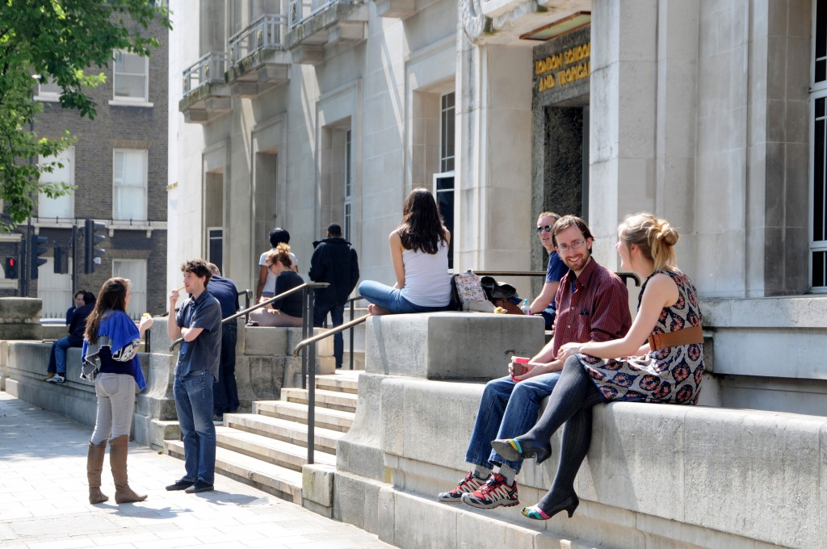
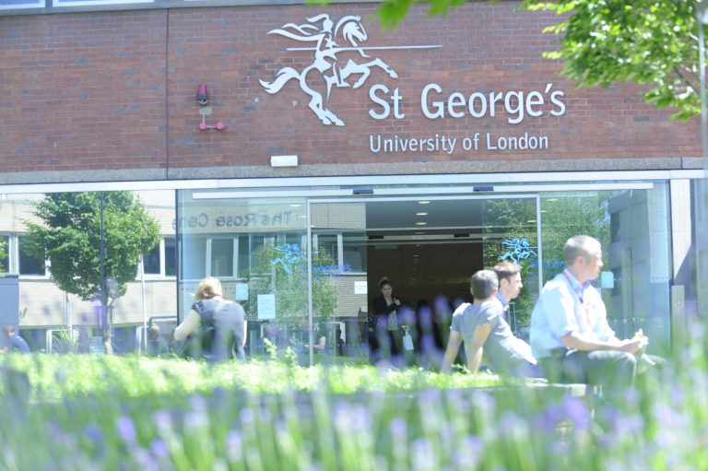
DTP Background
Partnership between LSHTM & SGUL
1. Doctoral Training Programme 1 (2016/17–2021/22):
66 studentships awarded
2. Doctoral Training Programme 2 (2022/23 – 2024/25):
Up to 27 studentships available (9 awarded)
Partnership based on
Shared research priorities
Examples are covered by broad themes of the DTP
Collaborative research
Examples include: Antimicrobial resistance; Genomic medicine; Understanding asthma; Cardiovascular disease; Built environment, lifestyle and health
Complementary training
Examples include: Genomic Medicine; Quantitative skills; Interdisciplinary skills
Enhanced by geographical proximity (Northern Line) & international partnerships and collaborations.

Slide 3
DTP Board
Role of DTP Board
Strategic direction
Ensure DTP meets MRC/UKRI requirements
Oversee finance and administration of the DTP funding
Supervisor & project selection
Recruit students based on potential and motivation
Mentor students
Support exceptional, student-led training
RESPONSIBILITIES | LSHTM | SGUL
DTP Lead/Co-chair | Neil Pearce | Carwyn Hooper
Institutional oversight | Suzanne Filteau
Equity, Diversity & Inclusion | Julia Pescarini (for Elizabeth Brickley) | Vanessa Ho
Industrial partnerships | Ian Douglas | Alexis Bailey
Theme: Global Health | Moffat Nyirenda | Phil Cooper
Theme: Health Data Science | Elizabeth Williamson | Julia Critchley
Theme: Translational & Implementation Research | Martin McKee & Adrianna Murphy | Julian Ma
Theme: Infectious Disease | John Edmunds | Jodi Lindsay
Non-specific | Cally Roper | Rachel Allen
Student representatives | 2022-23 tbc | Ella Whittle

Slide 4
How does the DTP fit within institutions?
Student Representation
Research Degree Committees at LSHTM & SGUL registration, performance monitoring, regulation
MRC LID Board Funding strategic direction & programme management

Slide 5
Studentship Awards
Training opportunities
3 month FTE placement Fees + Stipend (living allowance)
Research Training & Support Grant (RTSG) allowance + Travel & conference allowance
Additional flexible funding
1+4 Award 1 year FTE Masters & 4 years FTE PhD
+4 Award
4 years FTE PhD
iCASE
See separate MRC LID video for more detail on your funding.

Slide 6
Research project
Before your project was advertised, the board measured it against these criteria (to ensure that projects are well-thought through; meet MRC skills criteria; and meet promises our DTP made to MRC during the grant bid).
And so…
Theme
Does the project address an important issue in an MRC LID theme?
Training
Is the project student-centred?
Team
Collaboration
Is there collaboration and/or co-supervision between DTP partners?
Does the project provide high quality skills training in one or more MRC strategic skills areas?
Can the project be carried out within your RTSG allowance (with other training too)?
And/or Do the supervisory team have access to sufficient additional research funds to fund the project?
Funding
Does the supervisory team have a good track record in research?
Have all supervisory team members undertaken required MRC LID and institutional training?
Are the supervisory team engaged with DTP EDI focus?
Are there opportunities for external collaboration?
If the project has an international focus, are there opportunities to engage overseas collaborators in the supervisory team?
any changes to either
project or
supervisory team
must be approved by MRC LID board before they go ahead.
Any changes must also be approved by the primary institution, as per standard research degree regulations and processes.

Slide 7
Training & other opportunities Exceptional; student-led; more than a standard PhD
INDIVIDUAL
Research project Excellent supervision of a student-centered, interdisciplinary high quality research project with a focus on at least one MRC priority skill
Additional skills As determined by student, supervisors, and MRC LID mentor (modules; external options)
Internship/Placement
COHORT
Institutional Transferable skills training (compulsory) DTP (MRC LID & other MRC-funded students) Various training sessions throughout the year, including two cohort days (100% attendance expected) Peer support Public engagement

Slide 8
Conferences & Travel
Travel & conference attendance likely to vary depending on student and area of study.
MRC LID expects conference attendance over duration of award of
two UK or EU conferences
one overseas conference.
Travel & conference allowance should be used for travel/accommodation. If more is required students can dip into their RTSG allowance (if it’s available). RTSG funds can be used for formal conference dinner but not other food & drink.
Your primary institution may have other sources of funding for research degree students to attend conferences. Please check.

Slide 9
Placement/Internship Compulsory (not optional)
Duration
3 months FTE
What?
Up to you.
Where?
Up to you.
When?
What money?
How?
Start discussions with host
Please discuss potential visa implications with us at early planning stage.
After upgrading.
At a time that best suits your research & host institution.
Support for
Use RTSG allowance first.
May be some flexible funding available
Travel
Accommodation
Submit project approval request to board
Discuss funding arrangements with DTP Manager
Check whether collaboration agreement is required
Must be completely unconnected to your PhD project.
Possibly health & travel insurance

Slide 10
Reporting & admin
Some examples of key information we need to get from you at various stages through your award (and after) to fulfil our reporting obligations. This information is used by the MRC to determine outputs and individual and DTP impacts, and to assess HEIs. The information (and quality of information) provided may have implications for future funding and awards. Please help us to support you by engaging with the programme and responding to requests for this (and any other) information.
Je-S
RTSG actual expenditure
Annual Training Plan
Profile on MRC LID pages
Flexible Funding Feedback Form
Placement Approval Request
Annual MRC Report
ResearchFish
Final destination data
Placement & Training Feedback Form

Slide 11
General information & key contacts
For general info about Research Degrees at your primary institution
For MRC LID queries, including about fees and stipend payments, flexible funding applications, reporting etc
SGUL Post Graduate Research Office
LSHTM - EPH
LSHTM - ITD
LSHTM - PHP
Derilyn Frusher
Jenny Fleming
Lauren Dalton
Helen White
Joanna Bending
Renee Olivel
MRC LID
MRC LID web pages (especially current students section)
LSHTM Scholarships Team
Lara Crawford, MRC LID Manager

