Slide 1

MRC London Intercollegiate Doctoral Training Partnership Studentships
Neil Pearce, Neil.Pearce@lshtm.ac.uk
Carwyn Hooper, chooper@sgul.ac.uk
Elizabeth Brickley, Elizabeth.Brickley@lshtm.ac.uk
Julia Pescarini, Julia.Pescarini1@lshtm.ac.uk
Vanessa Ho, vho@sgul.ac.uk
Lara Crawford, mrclid@lshtm.ac.uk

Slide 2
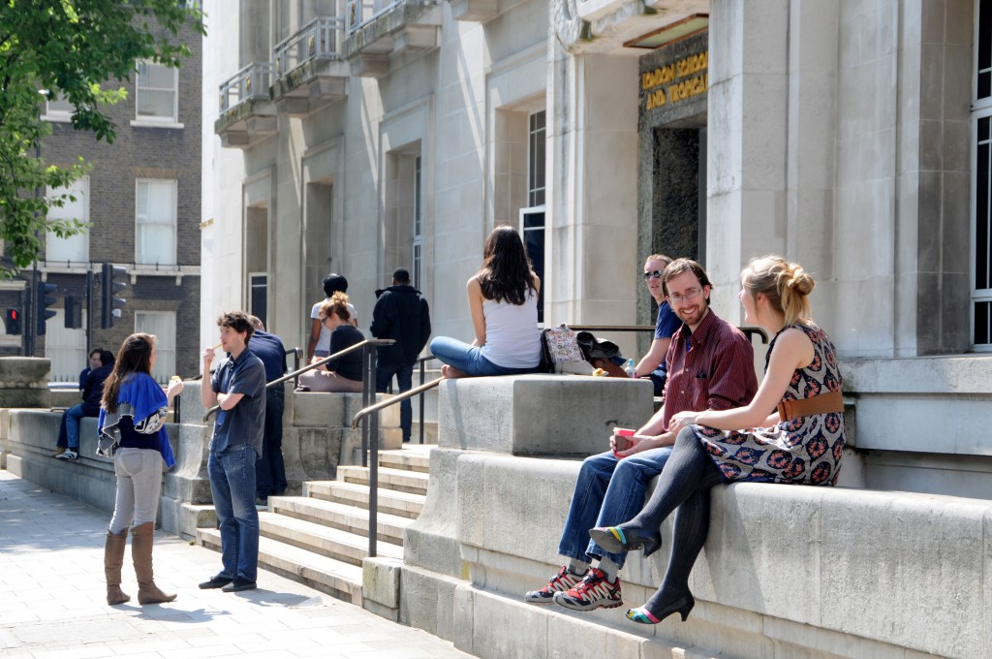

Program Overview
Partnership between LSHTM & St. George’s, University of London (SGUL)
Builds on successes of 7-year doctoral training partnership, which has administered 66 studentships.
Awards up to nine notional PhD studentships per year.
  Standard studentships of 4 years
  1+4 option of Master’s then PhD
Covers:
  Tuition fees & stipend
  Annual funding for research training, travel, and conference
  Competitive flexible funding for fieldwork, public engagement projects, etc.
Includes support for 3-month internship

Slide 3
MRC LID DTP Themes
Student-centered, interdisciplinary projects with a uniquely international focus
Global health
Health data science
Translational & implementation research
Infectious disease
Research to address health inequalities, including projects related to planetary health and climate change, global non-communicable disease, and health effects of sustainable development and urban design
Research utilizing quantitative skills, such as modelling, data analytics, artificial intelligence, and machine learning
Research emphasizing bench-to-bedside approaches as well as links to health policy and economics
Research focused on infectious diseases, encompassing both basic science and population-based approaches

Slide 4

mrc-lid.lshtm.ac.uk

Slide 5
EDI Strategy
Our strategy adopts a proactive approach to EDI with a firm commitment to anti-racism and to decolonising global public health research.
Mandating training for supervisors
Widening recruitment strategies
  Expanded links with Post ‘92 Universities
  Open Days and social media outreach
Taking positive action to recruit and support historically underrepresented groups
  Ring-fenced 1+4 scheme for UK minority ethnic students
  Pre- and post-acceptance mentoring by EDI leads
Increasing diversity on interview panels and board
Providing bursaries to students from LMICs
Creating flexible opportunities to support student carers
Using data and student engagement to monitor and evaluate impact of EDI strategy

Slide 6
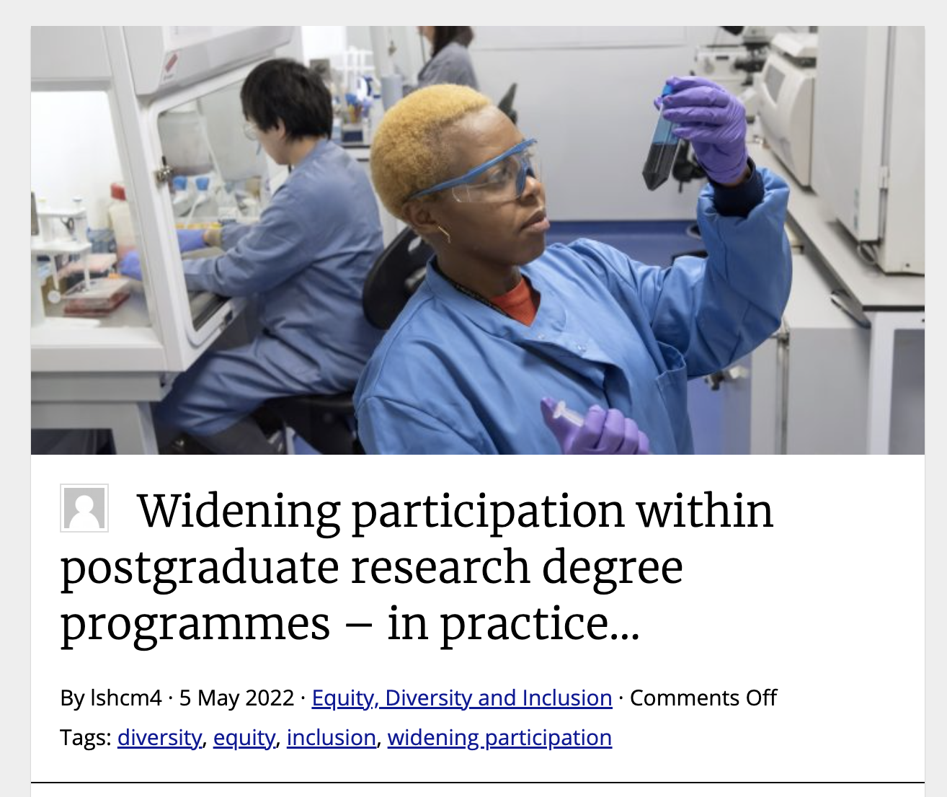
EDI Blog – Reflections from first year
https://blogs.lshtm.ac.uk/inclusion/2022/05/05/widening-participation-in-postgraduate-research-degree-programmes-in-practice/

Slide 7
Expectations for potential supervisors
Participating as a potential supervisor in MRC LID is a privilege.
We expect potential supervisors to approach their roles with respect for all applicants and a sense of personal responsibility to furthering the programme’s EDI, widening participation, and decolonising global public health strategies.
MRC LID is committed to recruiting a diverse student cohort. We value the academic and non-academic experiences people bring to our community and appreciate that a standard scholarship application may not address the personal and professional progression routes of our applicants.

Slide 8
Overview of timeline
Preparation
Supervisors complete mandatory training
Supervisors submit project proposals to MRC LID Board
Recruitment
MRC LID Board advertises approved projects on website
Candidates contact potential supervisory teams
Application
Candidates prepare applications & scientific proposals
Supervisors provide advice & feedback to candidates
Selection
Supervisors review applications & rank applicants
MRC LID Board reviews applications & shortlists applicants
MRC LID Board interviews shortlisted applicants

Slide 9
Overview of timeline
Preparation
Supervisors complete mandatory training
Supervisors submit project proposals to MRC LID Board
Recruitment
MRC LID Board advertises approved projects on website
Candidates contact potential supervisory teams
Application
Candidates prepare applications & scientific proposals
Supervisors provide advice & feedback to candidates
Selection
Supervisors review applications & rank applicants
MRC LID Board reviews applications & shortlists applicants
MRC LID Board interviews shortlisted applicants

Slide 10
Mandatory training for supervisors
All members of supervisory teams are required to complete mandatory training before 2023-24 projects are confirmed and advertised.
Overview of MRC LID & expectations for supervisors (this session)
Equality, diversity, and inclusion (EDI) and unconscious bias
Microaggressions and being an active bystander
If you will need to complete your training, please email staffdevelopment@lshtm.ac.uk.
Please note: If you completed trainings 2 and 3 in the last academic year, then you will not need to repeat your training for this round.

Slide 11
Overview of timeline
Preparation
Supervisors complete mandatory training
Supervisors submit project proposals to MRC LID Board
Recruitment
MRC LID Board advertises approved projects on website
Candidates contact potential supervisory teams
Application
Candidates prepare applications & scientific proposals
Supervisors provide advice & feedback to candidates
Selection
Supervisors review applications & rank applicants
MRC LID Board reviews applications & shortlists applicants
MRC LID Board interviews shortlisted applicants

Slide 12
Expectations for potential supervisors
When developing a project idea
  Reflect on your positionality
    What is your relationship to the research topic and populations impacted by the work?
  Consider the diversity within your supervisory team
    If the project has an international focus, are there opportunities to engage overseas collaborators in the supervisory team?
  Identify strategies for supporting a student’s success with the project
    How will you help the student to feel included in the research team?
    Who and which resources will be available to help the student overcome challenges along the way?

Slide 13
EDI in project proposal submission
Potential supervisors will submit projects by 23:59 on 10 Oct 2022 (provisional date).
Supervisors will be asked to reflect on widening participation & decolonising global public health.
What steps will you take to operationalize MRC LID’s commitment to widening participation when (i) meeting with applicants, (ii) assessing applications, and (iii) shortlisting candidates? (150 word max)
Please reflect on how the principles of decolonizing global public health may be relevant to the undertaking of this PhD project. What steps will you take to mitigate risks of this project perpetuating historical inequities? (150 word max)

Slide 14
Overview of timeline
Preparation
Supervisors complete mandatory training
Supervisors submit project proposals to MRC LID Board
Recruitment
MRC LID Board advertises approved projects on website
Candidates contact potential supervisory teams
Application
Candidates prepare applications & scientific proposals
Supervisors provide advice & feedback to candidates
Selection
Supervisors review applications & rank applicants
MRC LID Board reviews applications & shortlists applicants
MRC LID Board interviews shortlisted applicants

Slide 15

10-minute video for advertisements
When applicants reach out to potential supervisors, we want to ensure equity in the quality of interactions.
As a pilot initiative for this year, supervisory teams will be asked to prepare a 10-minute video overview about the project that can be posted alongside project advertisements. The video should:
Introduce the supervisory team
Provide an overview of the scientific objectives
Discuss potential methods and other considerations

Slide 16
Widening recruitment strategies
MRC LID is proactively working to widen our recruitment strategies and raise awareness of the ring-fenced scheme providing up to three 1+4 studentships per year for UK students from ethnic minority backgrounds.
We are advertising the programme to:
LSHTM Alumni Network
Higher Education Race Action Group
Leading Routes
HDR UK Black Interns Programme
Find a PhD
BBSTEM
Key contacts in Post ‘92 Universities
If you have additional suggestions for advertising the programme, please let us know at mrclid@lshtm.ac.uk.

Slide 17
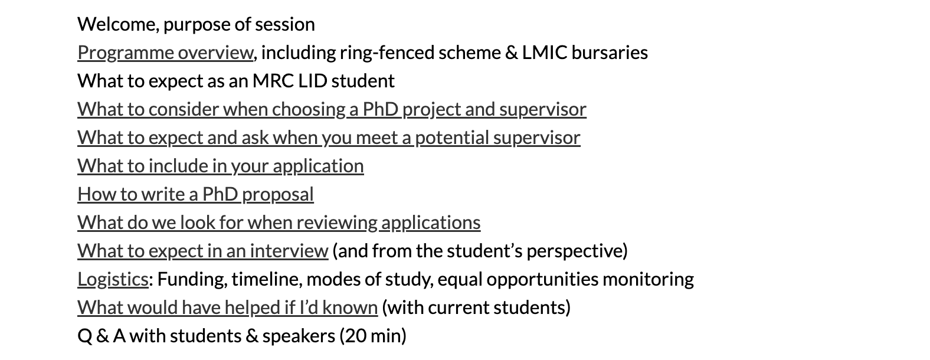
Virtual applicant workshop
If you would like to contribute to this year’s applicant workshop, please contact mrclid@lshtm.ac.uk.
Primary Aim: Demystify the application process
Presentations from staff & students
Opportunities for individualized support & mentoring

Slide 18
Overview of timeline
Preparation
Supervisors complete mandatory training
Supervisors submit project proposals to MRC LID Board
Recruitment
MRC LID Board advertises approved projects on website
Candidates contact potential supervisory teams
Application
Candidates prepare applications & scientific proposals
Supervisors provide advice & feedback to candidates
Selection
Supervisors review applications & rank applicants
MRC LID Board reviews applications & shortlists applicants
MRC LID Board interviews shortlisted applicants

Slide 19
Expectations for potential supervisors
Before you meet with students
  Consider your own unconscious biases
  Develop strategies for how you can mitigate the impact of any biases
When you meet with students
  Keep in mind that your interactions (positive or negative) with prospective students can have a lasting impact
  Be aware of the power dynamics. Create a respectful environment where applicants can feel comfortable asking questions
  Think about how you can play a role in demystifying the transition to postgraduate studies
  Consider how you can treat all applicants equitably, e.g. some 1+4 students may require additional support in approaching proposal writing

Slide 20
Overview of timeline
Preparation
Supervisors complete mandatory training
Supervisors submit project proposals to MRC LID Board
Recruitment
MRC LID Board advertises approved projects on website
Candidates contact potential supervisory teams
Application
Candidates prepare applications & scientific proposals
Supervisors provide advice & feedback to candidates
Selection
Supervisors review applications & rank applicants
MRC LID Board reviews applications & shortlists applicants
MRC LID Board interviews shortlisted applicants

Slide 21
Expectations for potential supervisors
When helping students develop their applications and scientific proposals
  Do not edit applicants’ proposals yourself
  Include comments (and no tracked changes) on word documents
  Point applicants to the 10 example proposals provided on the website

Slide 22
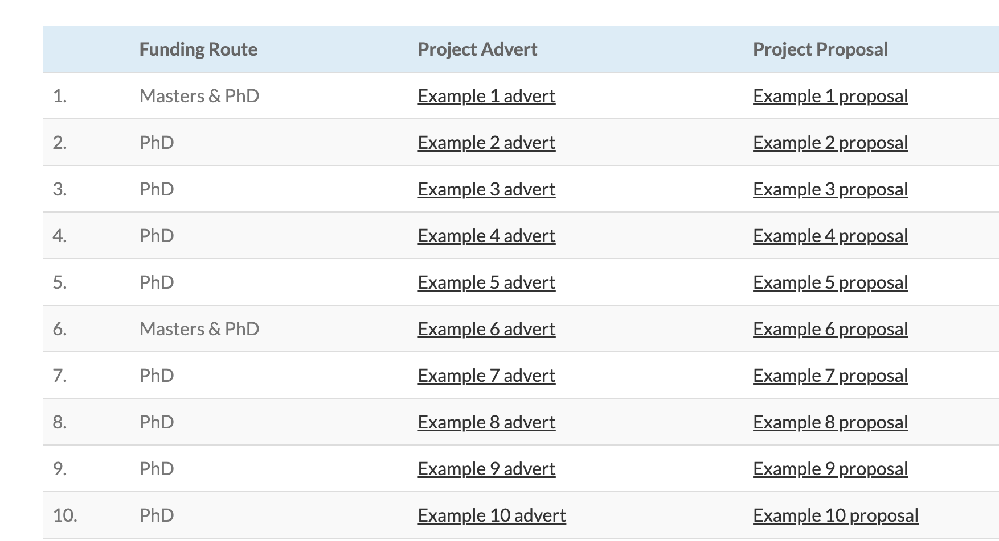
Examples of Past Successful Proposals
https://mrc-lid.lshtm.ac.uk/project-proposals/

Slide 23
Overview of timeline
Preparation
Supervisors complete mandatory training
Supervisors submit project proposals to MRC LID Board
Recruitment
MRC LID Board advertises approved projects on website
Candidates contact potential supervisory teams
Application
Candidates prepare applications & scientific proposals
Supervisors provide advice & feedback to candidates
Selection
Supervisors review applications & rank applicants
MRC LID Board reviews applications & shortlists applicants
MRC LID Board interviews shortlisted applicants

Slide 24
Expectations for potential supervisors
When reviewing applications and shortlisting candidates
  Use a holistic approach to your review. Alongside traditional measures of academic achievement, consider the additional strengths and lived experiences that an applicant may bring to a project
  Consider an applicant’s potential. Think of the applicant beyond just a single snapshot in time and consider their trajectory
  Remember that a 1+4 studentship is a possibility if additional training is needed to succeed in the doctoral project
  As a pilot initiative for this round, we have developed a rubric to help guide your team’s evaluations of project proposals.

Slide 25
Contextualized assessments
Educational achievements can be influenced by a range of factors. If the applicant shares contextual information (e.g., through questions on the application form), we ask supervisors to take into account any barriers applicants may have faced and the circumstances in which grades have been achieved.
Some potential circumstances to consider:
Being care experienced (e.g., living with foster carers)
Having caring responsibilities (e.g., caring for a child under 18 years)
Being first generation students in higher education
Being estranged from parents
Being a refugee or asylum seeker

Slide 26
Overview of timeline
Preparation
Supervisors complete mandatory training
Supervisors submit project proposals to MRC LID Board
Recruitment
MRC LID Board advertises approved projects on website
Candidates contact potential supervisory teams
Application
Candidates prepare applications & scientific proposals
Supervisors provide advice & feedback to candidates
Selection
Supervisors review applications & rank applicants
MRC LID Board reviews applications & shortlists applicants
MRC LID Board interviews shortlisted applicants

Slide 27
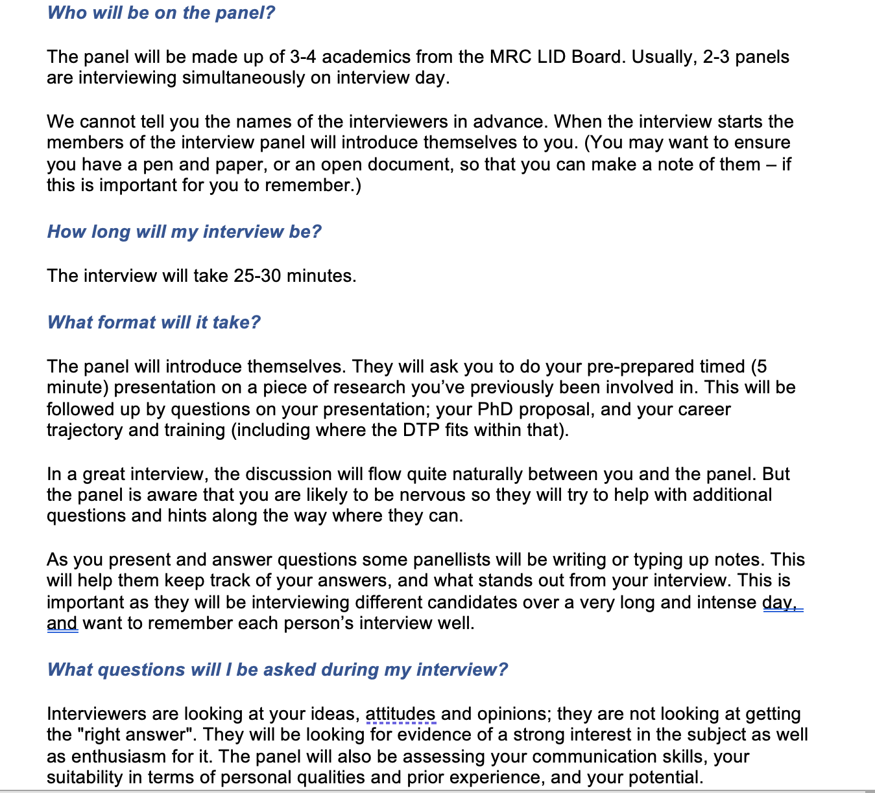
Interview Tips & Hints
Document shared with all shortlisted candidates
Logistics & practical information (what to wear, etc.)
FAQs
Example interview questions
Useful resources for learning about higher ed interviews

Slide 28
Additional information

Slide 29
Bursaries for students from LMICs
Students whose fee status is determined as ‘overseas’ will be required to cover the difference (~£15,000-20,000) between the UKRI tuition fee rate and the institutional ‘Overseas’ tuition fee rate.
UKRI policy requires that this must come from other sources of funding (i.e., alternative scholarship or bursary, but not personal funds).
Up to three applicants from LMICs will be eligible for a bursary from their institution (LSHTM or SGUL) to cover the difference of fees.
Please ensure applicants from HICs are aware that they are not eligible for institutional bursaries nor may they use personal funds to cover the top-up. Applicants may reach out to mrclid@lshtm.ac.uk for additional guidance specific to their individual case.

Slide 30
Additional support for student experience
Increase diversity on interview panels
Post-acceptance mentoring, esp. for 1+4 students
Support for student carers (e.g., helping to facilitate switch to part-time study if needed and possible)
Data monitoring
  An intersectional lens
  Not only admissions, but also student attainment once in the program
  Quantitative and qualitative information about student experience

Slide 31
For more information or to get involved
https://mrc-lid.lshtm.ac.uk/
MRC LID Administrator – Lara Crawford, mrclid@lshtm.ac.uk
LSHTM Academic Lead – Prof. Neil Pearce, neil.pearce@lshtm.ac.uk
SGUL Academic Lead – Dr. Carwyn Hooper, chooper@sgul.ac.uk
LSHTM EDI Lead – Dr. Elizabeth Brickley, elizabeth.brickley@lshtm.ac.uk
LSHTM EDI Lead – Dr. Julia Pescarini, julia.pescarini1@lshtm.ac.uk
SGUL EDI Lead – Dr. Vanessa Ho, vho@sgul.ac.uk

